Slide 1


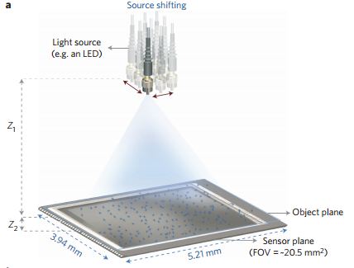
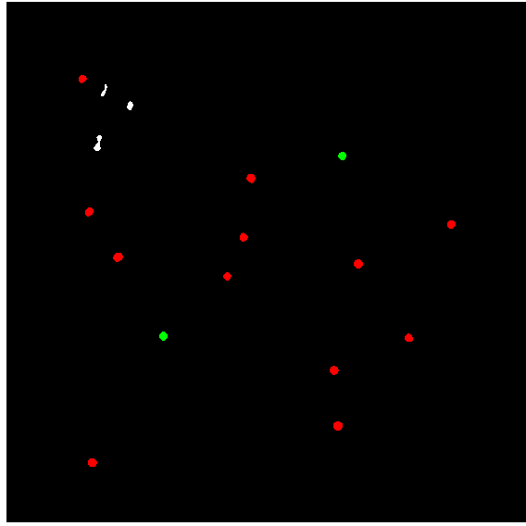
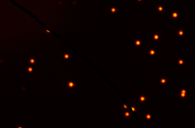

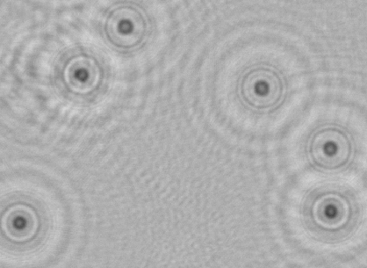
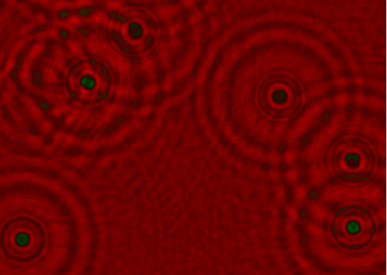
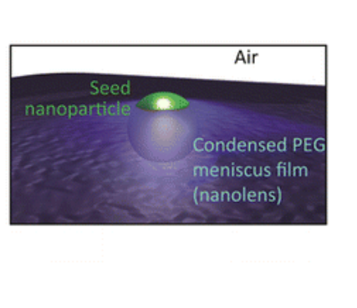
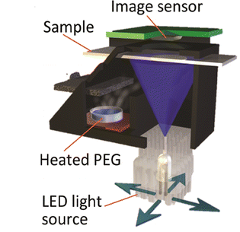
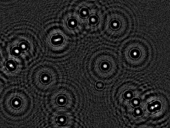














Color-Based Classification of Microscale Objects Using Lensfree Imaging
Ren Odion, Zhao Yang, Yuki Chen, Eddie Yan, Euan Mcleod, Steve Feng, Haydar Ozkan, Aydogan Ozcan
Departments of Electrical Engineering and Bioengineering, University of California, Los Angeles, CA 90025 USA
Abstract and Introduction
Materials and Methods (cont’)
Results (cont’)
One reason that microscopy is an essential tool for biomedical diagnostics is its ability to resolve individual cells. The process of staining biomedical samples with coloring agents is often required to enable diagnostic evaluation. Examples of such staining tests include DNA or protein microarray assays for specific disease detection, Papanicolaou smears to test for cervical cancer, and blood smears to count relative populations of different cells. Lensfree holographic imaging is a microscopy approach that we have developed that simultaneously provides a high resolution image with a field of view several orders of magnitude larger than conventional microscopy. However, lensfree holographic imaging in its simplest form is not well-suited for color imaging due to the need for a partially-coherent light source. Here we address this challenge through the use of sequential images acquired from sources of different wavelengths. The resulting stack or “cube” of images constitutes a “hyperspectral” image of the sample. As a proof-of-concept, we use dyed beads of different colors to test the performance of the system, and have developed an automated image processing procedure to discriminate between differently-colored beads. Our results indicate that we are able to differentiate micron-sized beads from each other by color with a classification accuracy of 95%. In the future we expect to extend this work to the discrimination of biologically-relevant samples.
Source Shifting
The reconstructed image is then compared to the red and green channel binary images created from the fluorescent images.
If the point appears in both (or appears in neither), the point is colored white for dust.
If it appears in only one channel, that bead is labelled to that corresponding color.
This labelling algorithm had a 90% accuracy rate in machine learning.
Light Source
Object Plane
Sensor Plane
Another labelling method uses the intensity of a specific color of bead across the spectra used by the coherent light source.
One randomly chosen colored bead or dust particle is used to compare intensity signals with the beads from the reconstructed image.
The result was around 95% labelling accuracy in machine learning.
The light source is shifted slightly in increments of 0.1 mm, capturing multiple diffraction hologram images.
A single pixel is made from the sub-pixel shifted holograms and reconstructed to form the hyperspectral phase and amplitude images of the individual nanoparticles and nanolenses.
The sample is later taken to a fluorescent microscope to get fluorescent images as gold standard comparisons to the hyperspectral images.
Intensity
Results
Wavelength
Materials and Methods
Samples are made by diluting a stock bead solution by a factor of 100.
Two types fluorescent beads (green and red) of 5 um size are mixed together.
The final concentration of each sample is 0.02% w/v.
3 uL of this solution is placed onto a glass coverslip.
The sample is then taken to a set up that vapor condenses nanolenses around the beads.
The beads are imaged using holography, sampling the diffraction patterns of each individual nanolens/particle complex.
The coherent light source scans at multiple wavelengths from 480 nm to 700 nm.
5 um beads reconstructed amplitude
5 um beads reconstructed phase
5 um red beads fluorescent
5 um red beads binary
The last labelling method involves looking at the signal difference for each bead color at one wavelength.
The method still needs machine learning testing.
To begin the labelling process, a small region of interest is chosen in the fluorescent image and transformed into a binary image using set RGB thresholds. This is done for both the red and green channels.
Conclusion
We managed to successfully differentiate micron sized beads based on simple color difference. We hope to expand this classification process to other features such as size or shape.
Acknowledgements
5 um beads reconstructed phase
5 um beads with segmented mask
We thank the Howard Hughes Undergraduate Research Program for their funding and support .
A small region of interest is then chosen for comparison and a segmented mask is applied.

